Slide 1
Optimizing a F2P Game Economy
Haitian Yu
4490Z
Computer Science – western university
Professor mike katchabaw
Notes:
- Good Afternoon! My name is Haitian and I’m happy to be here today to talk about my thesis research – optimizing a F2P game economy.

Slide 2
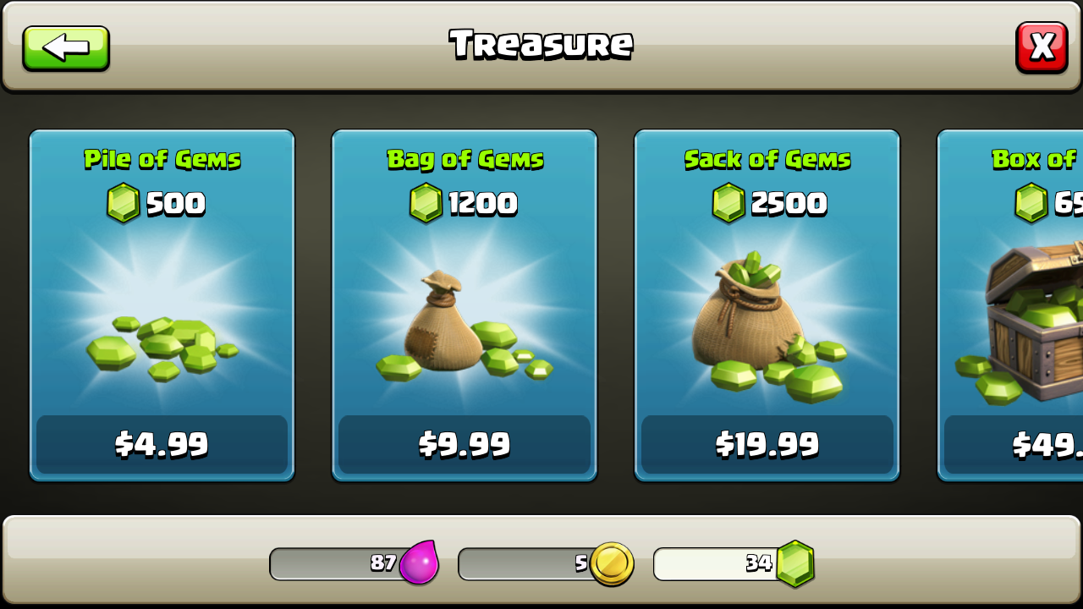
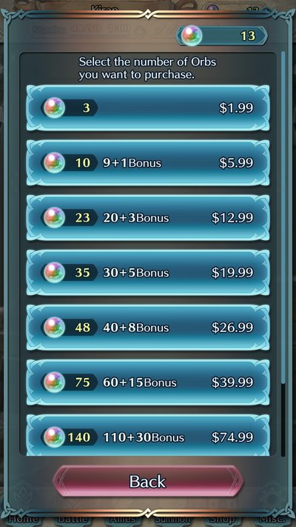
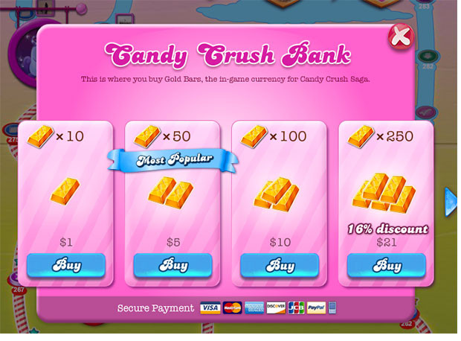
Introduction
Every Game Has a Game Economy… How Do You Optimize?
Lack of Research and Quantitative Data
Notes:
Context:
A game economy is very similar to the economy in real life. Players can acquire currency and spend it to purchase items that will help them progress through the game, change how they look, or even unlock additional game content.
Every game has an economy because not only does it help to incentivize the player, but it is a very good tool used for directing action.
Therefore, a good game economy = improved player immersion, more playtime, and in the case of F2P’s, increased revenue for developers.
So in a nutshell, the basic idea behind my research is how do we get players of F2P games to click on those big, shiny buy buttons more?
Current Situation:
Currently, research in game economy optimization, is very scattered with no data to support claims
For example, people do not know how many resource loops is optimal, or how much to increase sinks in comparison to sources.
My research was to help answer these questions and contribute to research to the field as a whole. I have focused on source/sink optimization, source/sink gap optimization, and end-game optimization.
Results:
I collected data, both from playing games myself and looking online, analyzed the data for insights, interviewed players, and read through forums all to try and contribute some data to the field.
Findings in 3 categories
For source/sink optimization, optimal resource loops: 4
For source/sink gap analysis, 3 key findings: 1. delaying the source/sink gap is bad 2. gap growth is tied to progress 3. sink should drastically outpace source @ 70%
For end-game, most data is qualitative but have found traits that are common to good end-games
Impact:
Help to further research in field by providing numerical data
Help developers streamline game design process
Work towards a game economy framework that developers can use to develop a game economy
All in all, research should help to improve game economy design for future F2P titles and help to improve the immersion for players
Lets go into more detail

Slide 3
Table of Contents
Background & Related Work
Research Methodology
Results
Analysis
Impact
Conclusions
Future Work and Lessons Learnt
Questions
Notes:
Agenda for the presentation

Slide 4
Background and Related Work
Source/Sink Research
Source/Sink Types
Optimal Numbers
Game Economy Optimization
Lack of Research
What is Common in F2P Games?
Optimal End Game Creation
Types of End Game
Little Research on Optimization
Hoarding
What is Hoarding?
Common Techniques to Combat It
Notes:
Research is focused on a closed economy (no imports in and no exports out) and there is no influence from inflation or trade
Source/Sink Research:
Limited to types of sources/sinks
Generators: background like process that continuously provides resources
Event-based: gives resources when certain conditions are met like completing a quest or killing an enemy
Single input: very much like event-based but only happens once. Usually reserved for bosses and story driven events
sinks follow the exact same pattern as sources
Game Economy Optimization:
Very scattered but there a few common points
Multiple currencies is more effective than single currencies (to differentiate between premium and non-premium)
Should try to immerse player in game before monetizing
Have multiple resource loops
Must have adequate sinks to promote purchases
Start users with a little premium currency to allow them to experience the benefits
Progression should make buying things more difficult
Gambling engages uses longer
End Game:
Fixed ending: common to AAA games, fixed ending is a final test for the player that should leave the player satisfied with both the story ending and mechanical requirements
Scaling ending: the game scales infinitely with time, but be careful because players can get bored quick
Ascension/prestige: player can restart the game when completed and will be rewarded with a unique item. Nowadays it is not enough to just reward, there should be differences in playthroughs
Hoarding:
Researched this because hoarding is a common tactic that can hurt end game (players save too many resources which makes paying currency trivial)
Caused by people wanting to “save” for when the resource is really needed
“Player is willing to make the game hard for themselves in the short term to prepare for potential problems”
Research says that developers should make the resource abundant with many opportunities to spend or limit capacity
Or develop a game that is focused on short term, for example dark souls.

Slide 5
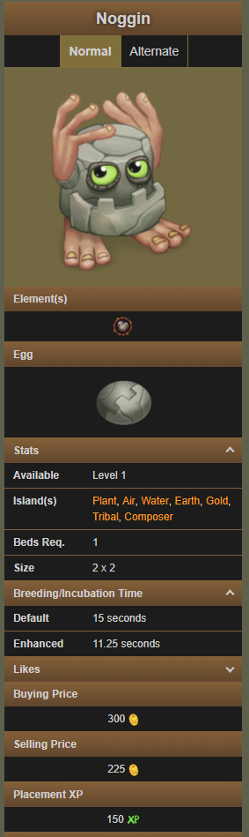
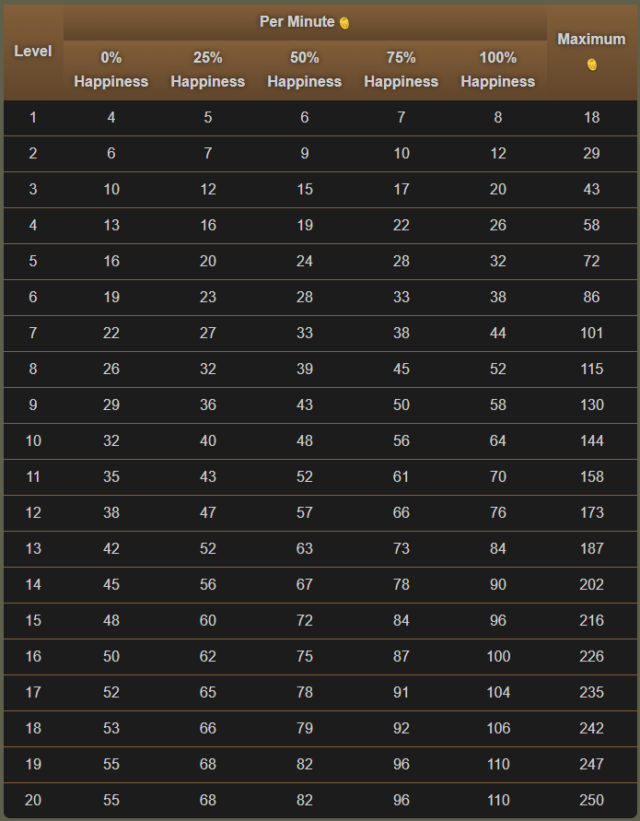
Research Methodology
Qualitative Research
Background Research
Playing Games
Player Interviews/Reading Forums
Quantitative Research
Data Collection
Data Analysis
Notes:
Quantitative:
Data Collection:
Played 4 F2P games for understanding and collecting data
FE Heroes, Candy Crush, Clash of Clans, My Singing Monsters
Tried to play a game for minimum 15 hours to collect enough data and progress far enough into game
To supplement, Wikia was used because it contained up to date data
Playstyle data was collected to better understand common playstyles (ex. people like to purchase items as soon as available)
Try to supplement my conservative playstyle
Data Analysis
Analysis primary in Excel.
After data collection, data had to be organized and cleaned (ex. personal data and Wikia data conflicted)
Data analyzed to find source/sink numbers, gap growth, etc.
Data was graphed to help show trends and help with understanding
Finally, data was combined to try and find holistic insights
Qualitative:
Unfortunately, limited because of time constraints
Original plan was to interview players of the game, release surveys and analyze responses, and interview game developers but could only do first
Tried to supplement with reading online forums and discussions about the games
Friends and acquaintances were interviewed about playstyles, whether or not they purchased currency, their opinions on the game’s economy, etc.
Forums were scanned for similar information

Slide 6
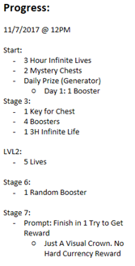
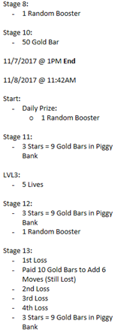
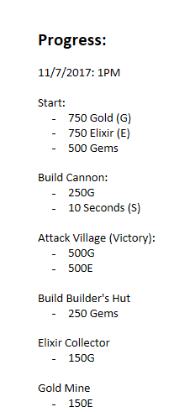
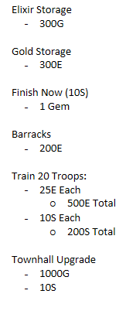
Example - Game Tracking Logs
Candy Crush
Clash of Clans

Slide 7
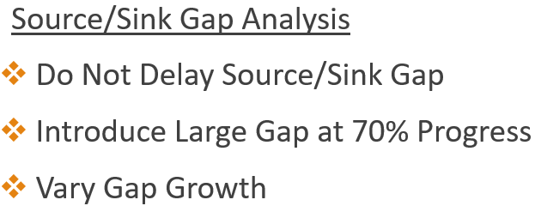
Results
Source/Sink Analysis
Average of 4.5 Sources/Sinks
Recommendation: 3-4 Unique Resource Loops
End-Game Analysis
Which F2P Had Best End Game?
Notes:
The following is an overall summary of the results.
As discussed earlier, my research focused on three areas
Source/Sink Analysis:
The average number of sources or sinks was 4.5
Recommendation is 4 unique resource loops as a balance between keeping the player interested but not confusing the player
Source/Sink Gap Analysis:
3 key findings:
Contrary to past research, successful F2P games do not delay the source/sink gap
All games analyzed begin introducing a large gap at around 70% progress
And gap growth varies depending on player progression
End-Game Analysis:
Unfortunately, end-game analysis lacked quantitative data but I was able to research insights about which end-game of the four titles analyzed was ranked highest and why.
Lets dive into a more comprehensive view of each section

Slide 8
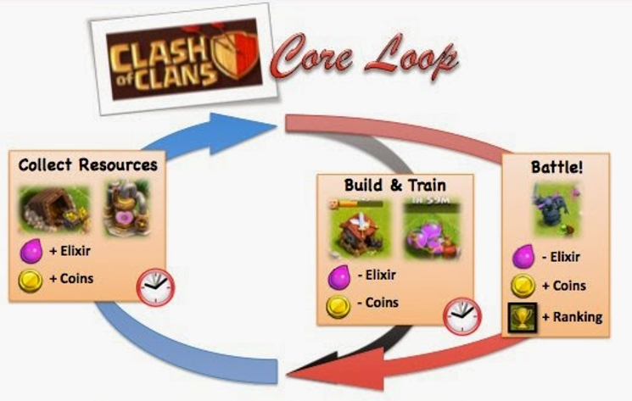
Results – Source/Sink Analysis
Source/Sink Analysis
Recommendation: 3-4 Unique Resource Loops
What is a Unique Resource Loop?
Multiple Loops = Higher Willingness to Pay
Notes:
We know past research has stated that increasing sources and sinks helps increase player immersion and playtime, but how many do successful games have?
All four titles had a range of sources and sinks
Highest: Fire Emblem Heroes with 7
Lowest: Candy Crush with 3
BUT, an important note is that just because Fire Emblem Heroes had 7 source/sink does not mean that many resource loops
So what is a resource loop? It is essentially when gathering and using a resource offer unique gameplay.
Ex. Clash of Clans
Ex. Fire Emblem Heroes
- 7 sources/sinks but 4 sources/sinks are for the same loop
Why loops important?
Keeps people playing b/c time is a factor in many games
Multiple opportunities to charge for more resources

Slide 9
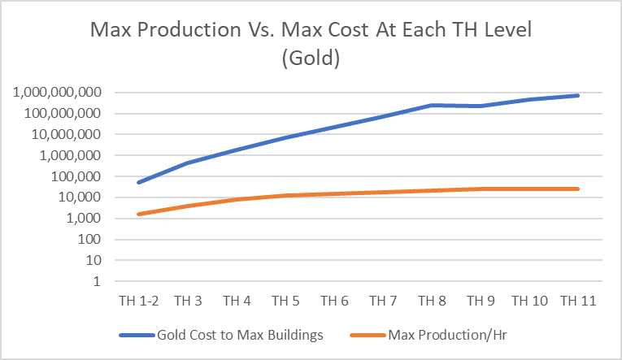
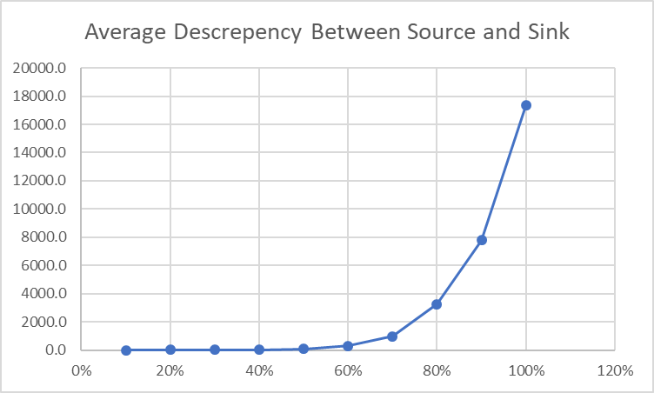
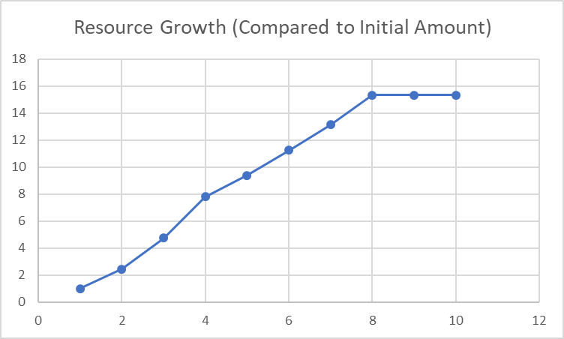
Results – Source/Sink Gap Analysis
1. Immediate Gap in Source/Sink
2. Multiplicative Difference Between Source and Sink Graphed Against Progression
3. Growth of Source Graphed Against Progression
Notes:
3 key insights:
Delaying the source sink gap may not be profitable
Introducing a large gap and exponentially growing it at 70% progress
Varying gap depending on player progression
As you can see from the first graph, there is an immediate source/sink gap.
The above graph is for Clash of Clans gold, but all other source/sink analysis’ show the exact same thing
Why, not sure but maybe because it gives players goals to strive towards
Often times, a little premium currency is offered so this is the perfect time to have player get a taste of how premium currency can remove the gap
Next, the source sink gap.
Graph 2 shows source/sink gap graphed against progression (explain descrepency [at 100% sink requirements are 18,000 times that of sources])
Really starts to break away at 70% and continues to grow exponentially
Helps to build the habit of using premium currency beforehand
The gap is not too large so player uses premium currency to make up gap, but when they reach 70% on onward, they are so used to using currency they will spend more and more to even the gap
This is why it is important to vary the gap depending on player progression. if you spike it too early, the player will be discouraged and will stop playing the game
If you spike too late then you lose on potential revenue
The third graph shows the growth of sources, and as you can see it is relatively linear. From there, you can use graph 2 to calculate the expected sink numbers to give developers a base framework of how to construct their economy.

Slide 10
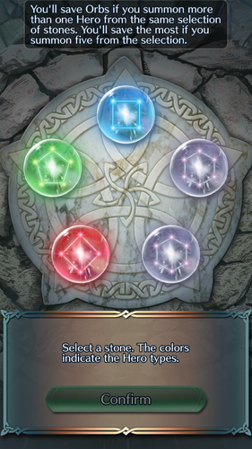
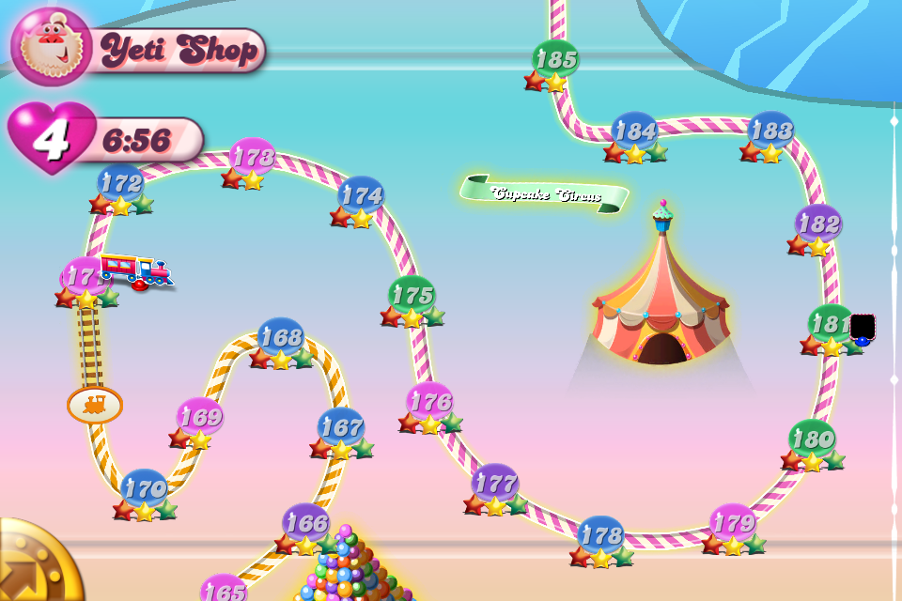
Results – End Game Analysis
Source/Sink Analysis
Lack of Quantitative Data
Heavy Reliance on Forums and Interview Responses
Restrict Resources and Incentivize Spending
Notes:
Unfortunately, analyzing the end-game was a relatively recent add-on to my research so I did not have a lot of time but I did discover a few interesting things
The general consensus is that Clash of Clans has a very good end-game and the reasoning will be discussed in the example on the next slide.
People also enjoyed Candy Crush because of the frequent updates to add new levels. In fact, there are currently over 3000 levels of Candy Crush to play which results in a huge opportunity for revenue.
A note of interest, Fire Emblem Heroes was generally liked because of its constant content updates, but it relies on a lootbox system to unlock special characters to be used in game.
Explain lootbox system
Lootboxes are known to be effective at incentivizing purchase, but many of the people I interviewed did not like the idea of it because it felt so much like gambling

Slide 11
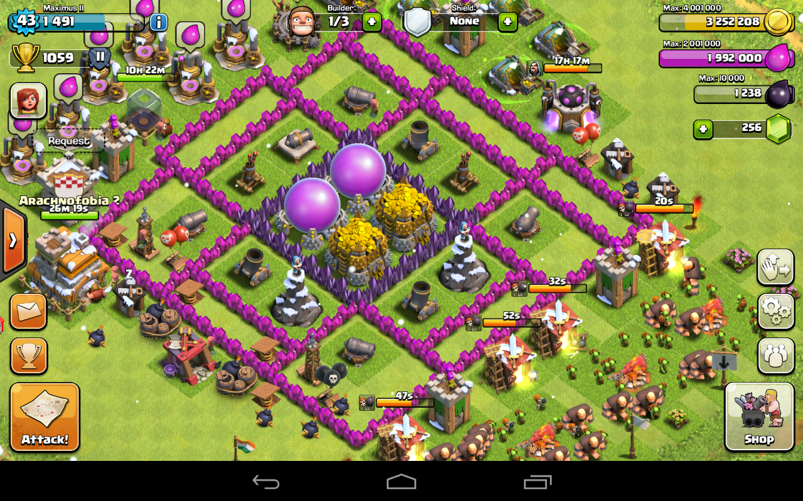
Example – Good End Game
Clash of Clans
Restricted Resources
Incentive to Spend
End Game Content
Notes:
So what makes clash of clans so successful?
It limits if resources. Unlike Candy Crush or Fire Emblem Heroes, which limit time played through lives or stamina, Clash of Clans actually restricts the resources players use to purchase items
As people save up currency, they are stored in storage containers
Unfortunately, you are always at risk of getting attacked and having your resources stolen which incentivizes purchase
- You can either purchase shields with premium currency or supplement saved resources with premium currency to purchase something and not risk raids
In summary, even in the end game it is impossible to hoard excessive resources because you can only store so much and it will most likely get taken away

Slide 12
Analysis
What’s Better? What’s Changed?
Added to Research in Sources, Sinks, Source/Sink Gap, and End-Game Optimization
Corrected Misinformation in Source/Sink Gap Analysis
Start Now vs. Wait for Player Immersion
Begin Building a Developer’s Framework
Limitations
Application of Research is Limited
Lack of Genres, Popularity, Playstyles, End-Game Archetypes, etc.
Lack of Complex Data
Lack of Data Quantity
Notes:
So what has my research improved? What’s changed?
My research will help to add both qualitative and quantitative data to current research on F2P economy optimization
Instead of just a blanket statement like “you should have a source/sink gap”, there is now data on what the gap should be at each stage of the game
Corrected misinformation in source/sink gap analysis
In the past it was believed that you should wait before introducing a source/sink gap because it would help player immersion
Developers may be losing revenue by delaying opportunity to teach player to use premium currency to make up the gap immediately
Lastly, with the additional data, it is possible to begin creating a framework that will help expedite the game design process.
In the past, creating a good game economy is a lot of trial and error. If it is too aggressive, players may not want to continue play but if it is too generous, the developer will lose out on revenue
The data will help to give developers a more clear starting point to reduce trial and error
Limitations:
Data collected from personal play, third party websites, and player interviews which all have biases
Playstyle is relatively conservative but was also different across games
Application is limited
Only a few genres
Only analyzed top games
Only analyzed F2P games
Very few playstyle changes
Lack of different end-games
Data was relatively simple because it was either collected myself or found online
No purchase data, player demographic data, etc. which could really help further analysis
- More data would help to solidify findings but also would help me run analysis in R

Slide 13
Impact
Better Understanding of Sources, Sinks, and the Source/Sink Gap
Better Understanding of End Game Optimization
Work Towards Developing a F2P Economy Framework
Work Towards Optimizing Resource Loops for Revenue
Average Resource Growth
Average Gap Discrepancy
Notes:
So how will my research impact the field?
As stated earlier, there will be more research on game economy optimization
Future research can build off of mine to help grow the field
The biggest impact is that the data and analysis, although not perfect, can expedite the game design process and help to create better F2P games
For example, a developer could use the two tables as a starting point for creating a resource loop (give example).
Therefore, the research has already begun to contribute towards developing a framework to help game creators to not only help them make more revenue, but create more immersive, fun games for their target markets.

Slide 14
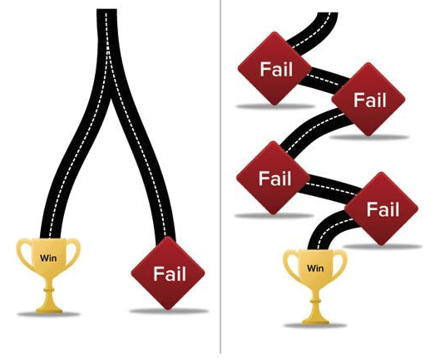
Conclusions
Past Research is Both Lacking and Outdated
Developers May Be Losing Revenue by Delaying the Source/Sink Gap
Balance # of Resource Loops
Source/Sink Gap Should Increase as Player Progresses
Notes:
We can make a few conclusions from the research:
First, past research is both unspecific and outdated which lead to the game development process looking like the right image
Developers had to rely heavily on trail and error to create a successful economy which wastes time and resources
The research has shown that it is not optimal to delay the source sink gap because it gives up the opportunity to teach the player to spend
The research has given data on how many resource loops the top grossing games use to maximize revenue
The research has shown how a source/sink gap should grow with progression and how long to wait before introducing a large gap
And finally, the research has given insight into how to create an efficient end-game
With this research, hopefully the path for developers can begin to look more like the left and less like the right.

Slide 15
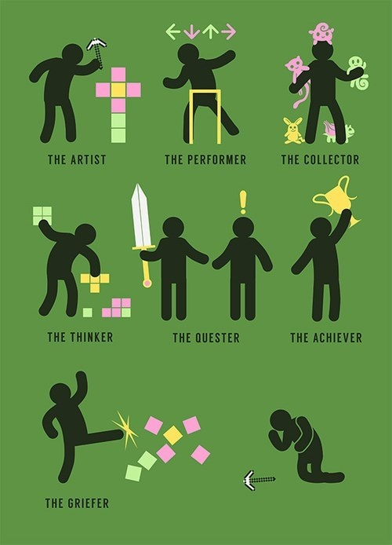
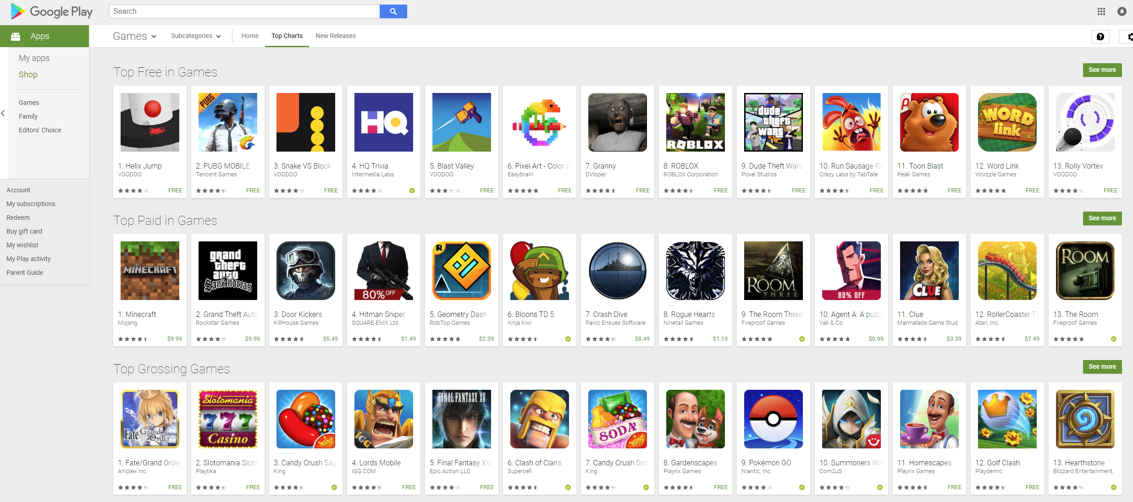


Future Work and Lessons Learnt
Future Work
More F2P Titles
Analyze Different Playstyles
Better Data Analysis
More Complex Data
Lessons Learnt
Quality of Data is Important
Efficiency is Key
Organization is Vital
Notes:
Future Work:

Slide 16
Questions?

Slide 17
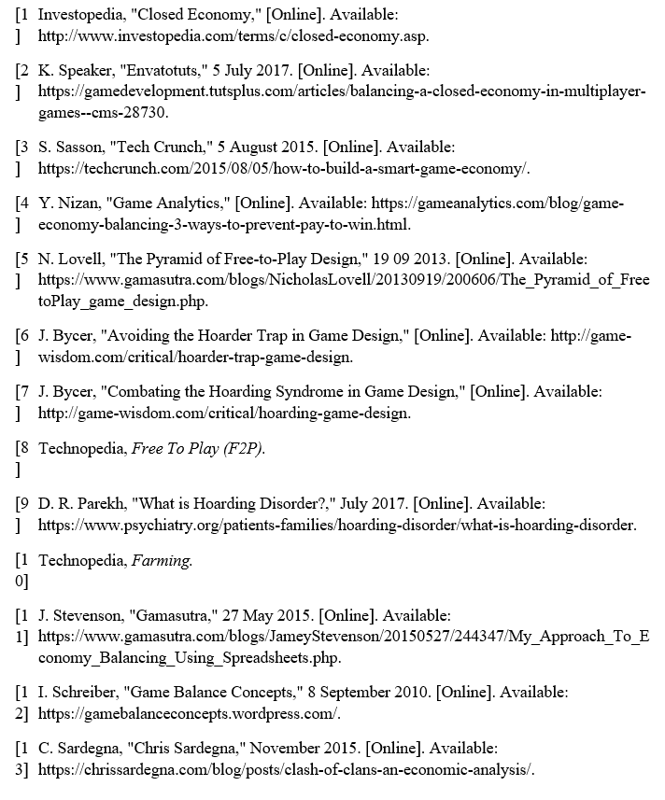
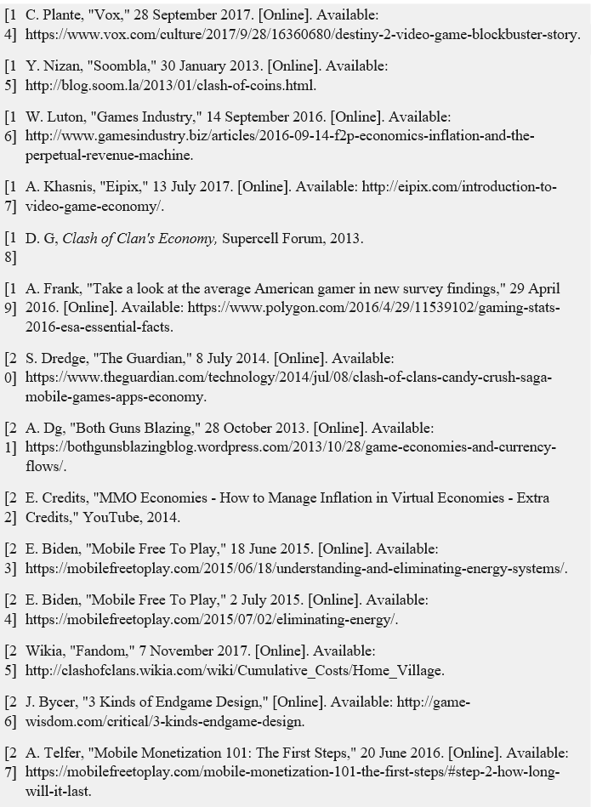
References

Slide 18
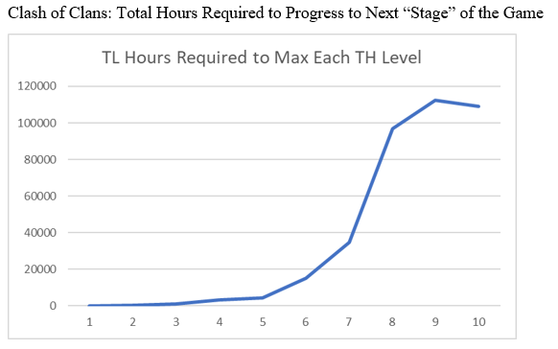
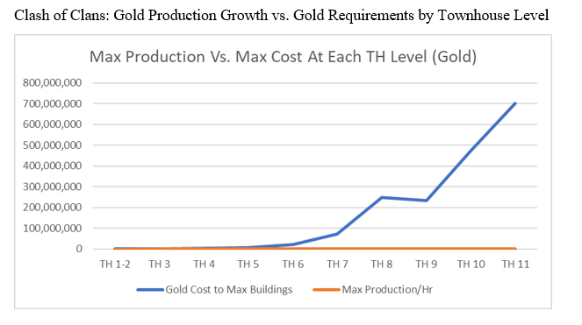
Appendix

Slide 19
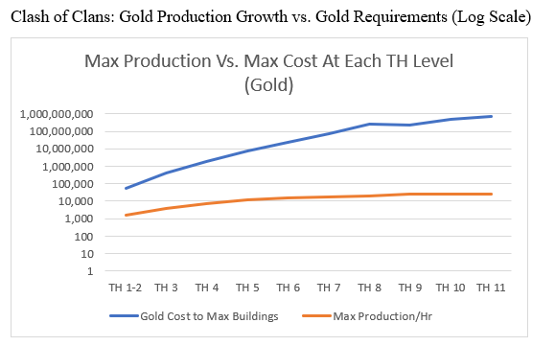
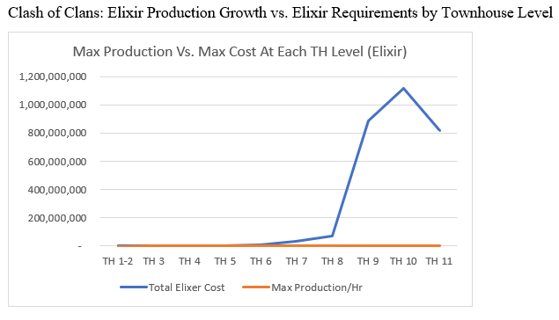
Appendix

Slide 20
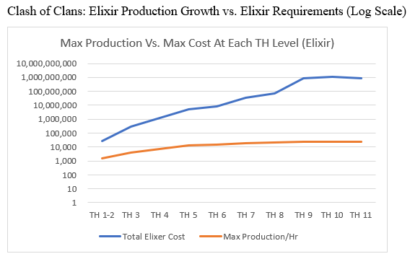
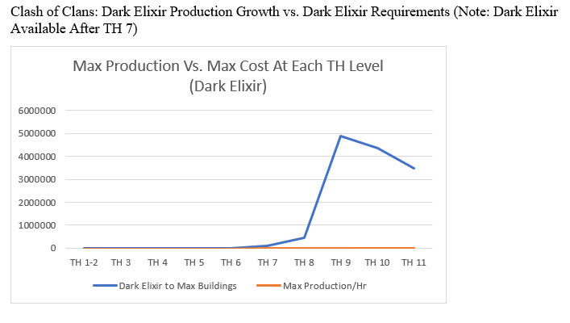
Appendix

Slide 21
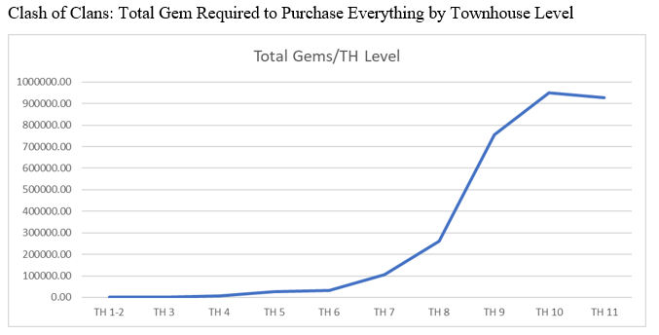
Appendix

Slide 22
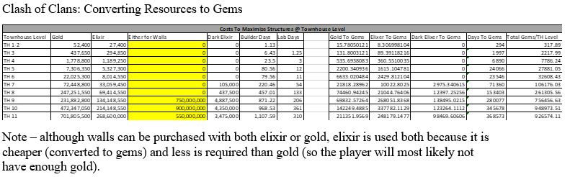
Appendix

Slide 23
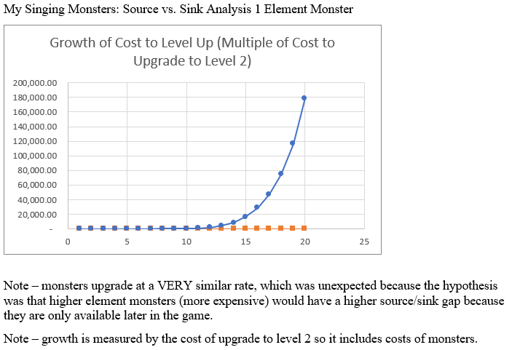
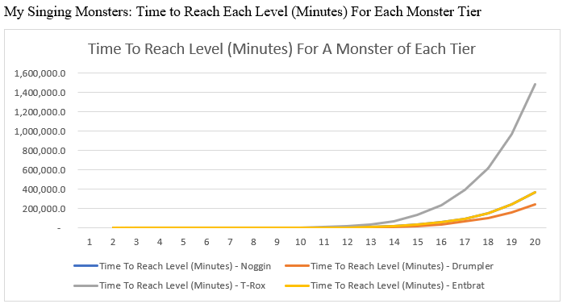
Appendix

Slide 24
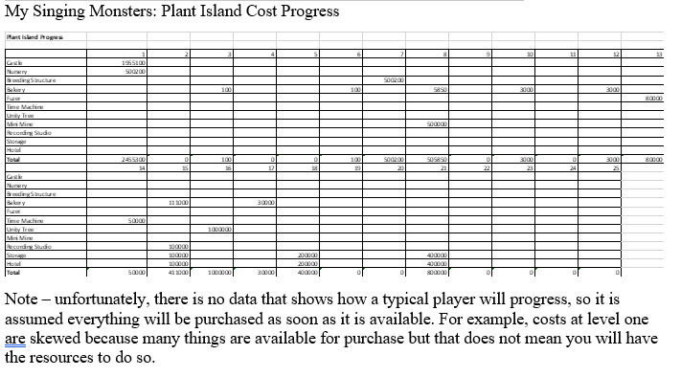
Appendix

Slide 25
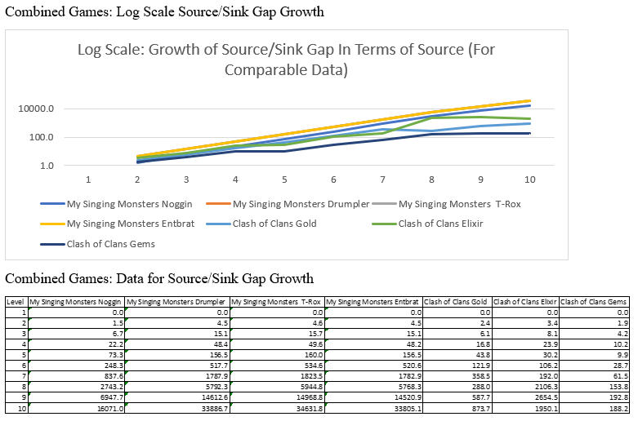
Appendix

